Slide 1
Test Management Tools
RECOMEDATION

Slide 2
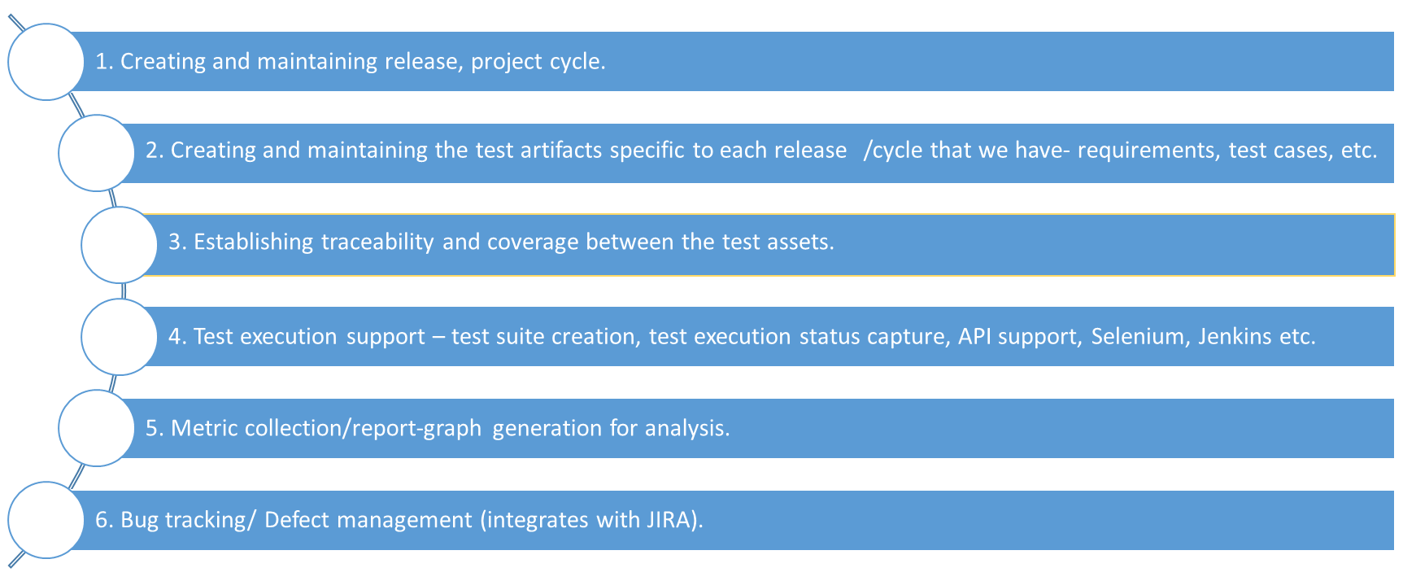
Requirements

Slide 3
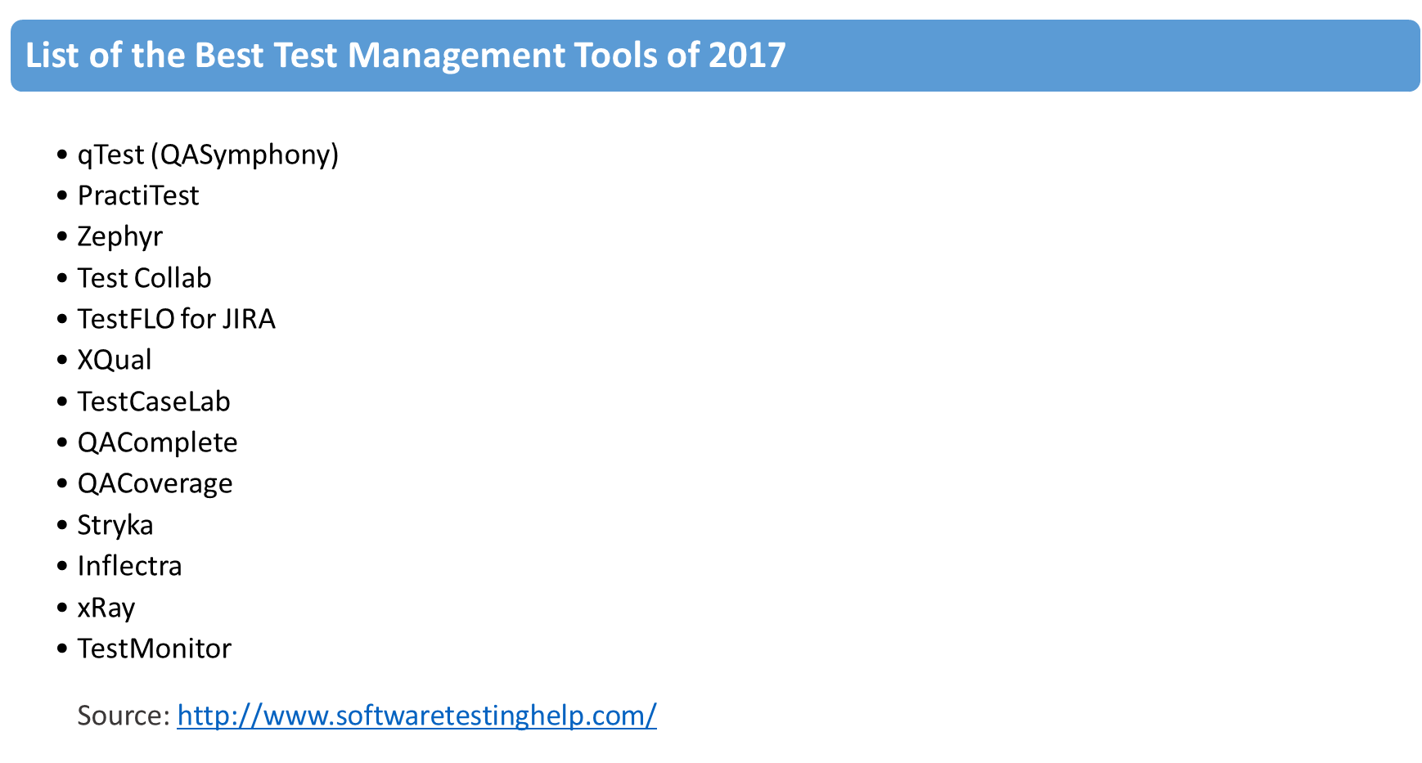

Slide 4
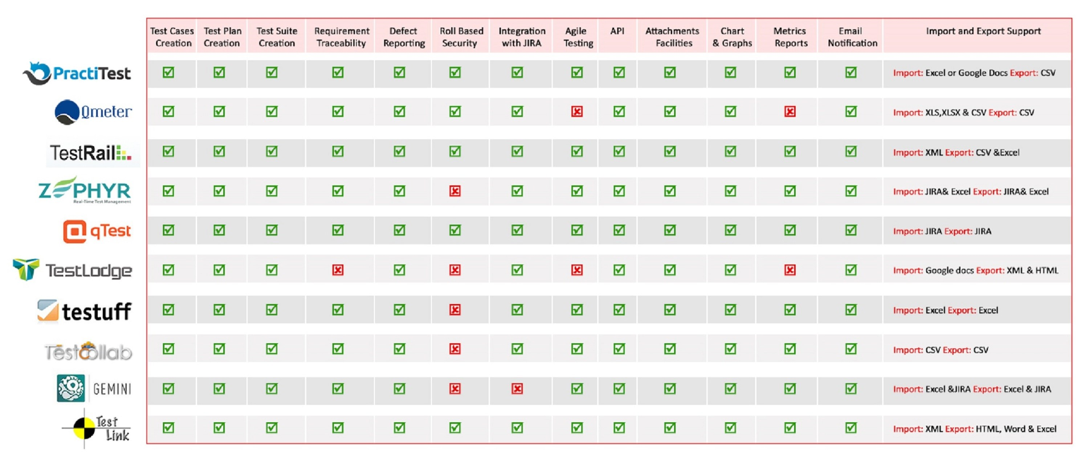
Comparison of Test Management Tools
Source: http://blogs.perficient.com/delivery/blog/2015/08/17/comparison-of-test-management-tools/

Slide 5
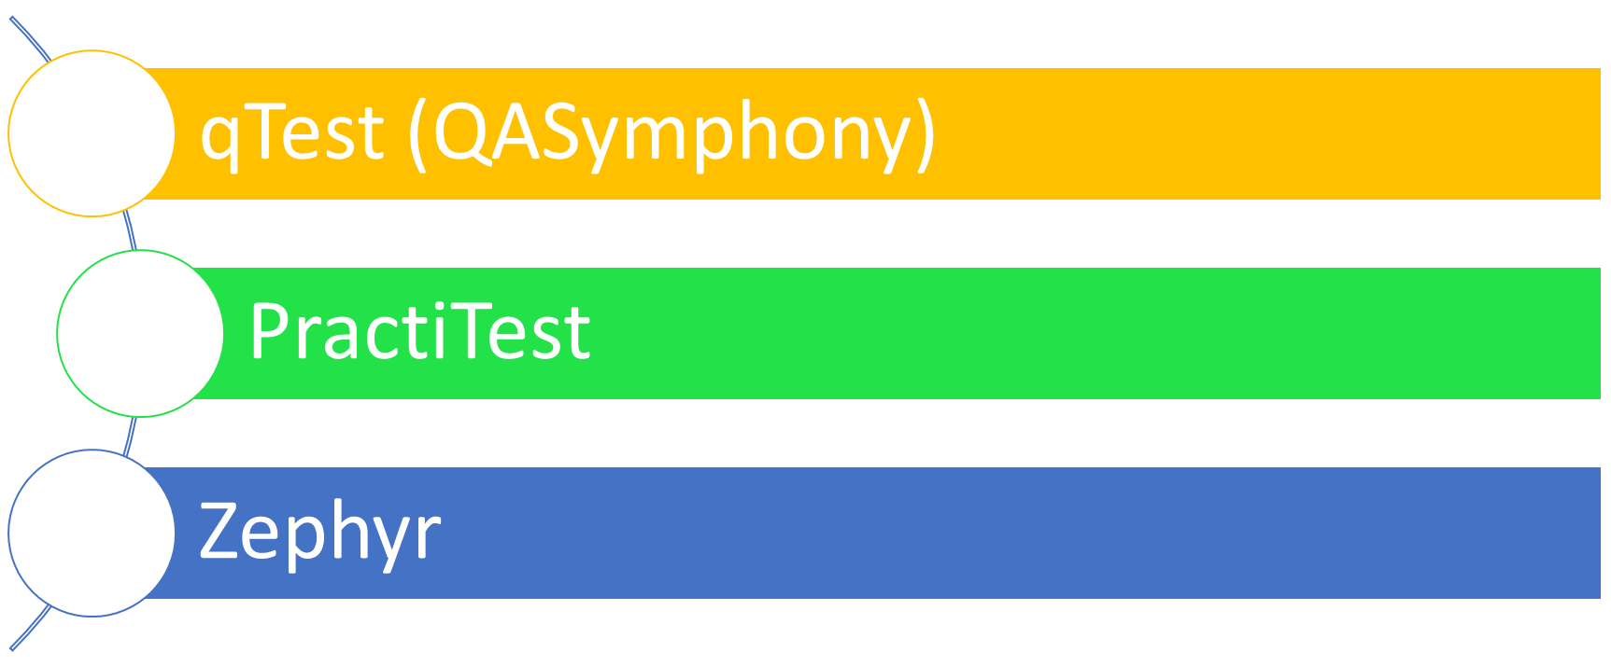
Top Pick

Slide 6

qTest provides software testing and development teams with an easy to learn, easy to use, lightning fast, scalable test management that seamlessly integrates with JIRA, other ALMs, and automation tools. qTest has proven to make every step of the QA process faster, simpler and more efficient.
Manage Requirements, Test case repository, Test Execution, Defect Tracking, Reporting, and Integrations.
qTest is one of fastest growing test management solutions on the market today amongst Agile testing and development teams. Be sure to add it to your short list of test management tools to trial.
qTest website – https://www.qasymphony.com/

Slide 7

An entirely SaaS end-to-end QA and Agile friendly Test management tool. Using their unique and customizable filters you can efficiently organize your requirements, create and run tests, track bugs and generate reports using this tool. It integrates seamlessly with leading bug tracking tools like JIRA, Pivotal tracker, Bugzilla, and Redmine as well as various automation tools such as Selenium, Jenkins etc. However, their API can ensure further customizing for your process’ needs.
It is not open sourced but is quite affordable. You can benefit from their human methodological support throughout your usage.
PractiTest website – http://www.practitest.com/

Slide 8

Zephyr is the #1 selling testing solution with more than 11,000 global customers (and growing) in 100+ countries, with over 20 million tests executed.
Zephyr offers innovative applications and unparalleled, real-time visibility into the quality and status of software projects. Integrate tools your teams are already using today such as JIRA, Selenium, QTP/UFT, Bamboo, Jenkins, Confluence and so much more via well-documented REST APIs. Their feature-rich products address today’s dynamic and global needs across a variety of industries including finance, healthcare, media, mobile, IT services, and enterprise software.
Zephyr website – Zephyr for JIRA

Slide 9
Feature Comparison
Blank Text Box.

